Slide 1
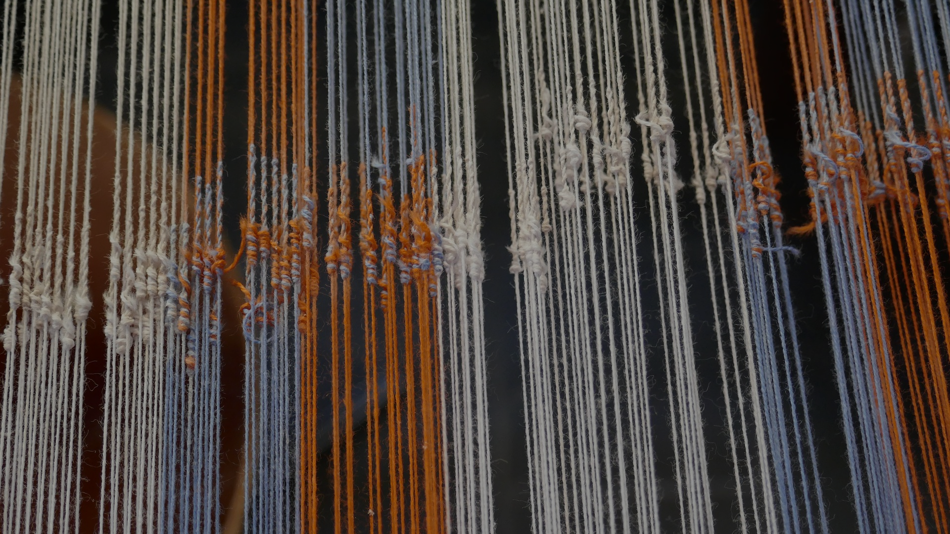
INTRODUCING THE TOK ESSAY
BQ3 Spin Lesson 3
I understand how to structure a TOK essay, and can list some characteristics of a good essay
Notes:
See how this lesson links to the course by viewing the final slide
Key TOK terms appear in a red font

Slide 2
Starter
Write down everything you know about the TOK essay.
Notes:
66% of the final mark
Chosen from a list of 6 ‘prescribed titles’
Done in the second year of the Diploma
1600 words long
Difficult
Characteristics of the essay include:
Second-order knowledge
Different perspectives
Linked to areas of knowledge
Use of real-life situations
Application of arguments and analysis
Your own perspective, opinion, judgement, experiences

Slide 3
Pairs
Read ‘Structuring the TOK essay’ document
Find at least one thing that you don’t understand
Notes:
Handout is here.

Slide 4
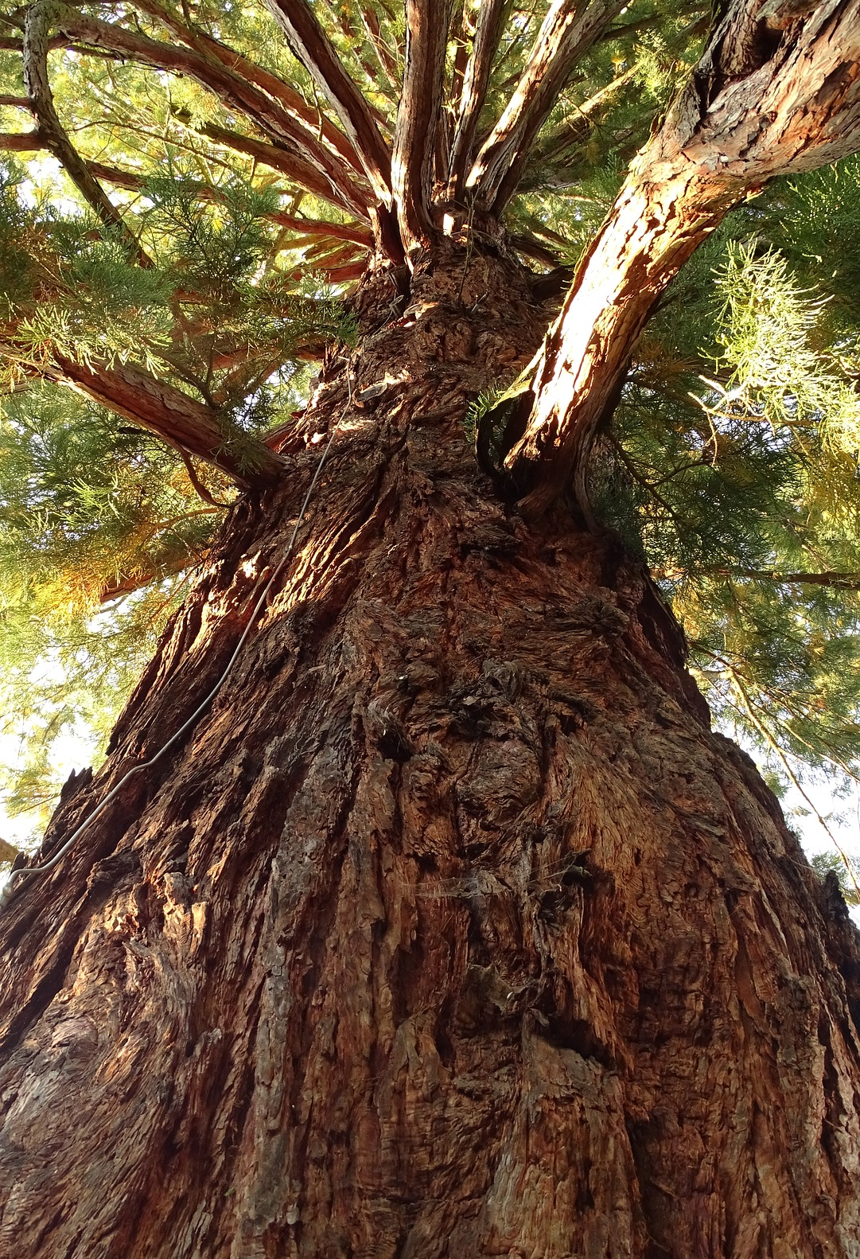
On BIG paper...
In pairs or threes, divide up your A3 paper into 7 different spaces. Express the elements of the TOK essay in visual form (diagrams, sketches, etc.). You may also use up to 5 words for each element -
Introduction
Argument 1
Argument 2
Challenging the question
Conclusion
Bibliography
Leave one part of the paper blank
Notes:
The more creative, the better!
This can be regularly drawn rectangles, or a much more abstract division of spaces

Slide 5
Read through the descriptions of essay characteristics
Decide which ones are EFFECTIVE, and which ones are INEFFECTIVE
Characteristics of a good TOK essay
Notes:
See next slide for answers - only one is surprising

Slide 6
Shows an awareness of his or her own perspective as a knower in relation to other perspectives
Argument in the essay are fully justified
Clear and coherent arguments
The arguments are effectively evaluated
Examples are fresh, original, and specific
Not enough personal thoughts and opinions
Too many generalizations
Misunderstandings about the AOKs -
RLSs chosen because of suitability rather than interest
Notes:
Last point arguably the surprising one
Teachers can add to this list of they want. It is not meant to be an exhaustive list.

Slide 7
Gallery walk
Which group has been the most creative and comprehensive?

Slide 8
What questions do you still have about how to write a TOK essay?
Notes:
Debrief, focusing on difficulties
See the BQ3 assessment tracker for suggestions on providing feedback, and recording students’ progress

Slide 9
Linking this lesson to the course
During this lesson, we consider the highlighted aspects of the TOK course
The images used in the presentation slides can also give students ideas about selecting exhibition objects
CORE THEME | OPTIONAL THEMES | AREAS OF KNOWLEDGE | TOK ASSESSMENT
Knowledge & the knower | Indigenous societies | The arts | The TOK essay
 | Language | History
 | Politics | The human sciences | The TOK exhibition
 | Religion | Mathematics
 | Technology | The natural sciences

Slide 10
Explore the TOK themes and areas of knowledge in more depth via a range of thinkers, media sources, and other resources, in our EXPLORATION POINTS DOCUMENTS.
Access the documents via the links below. You’ll also find the EP icons on all of the TOK course pages of the site to help you unpack the quotes, KQs, and real-life situations that you find there.
CORE THEME
Knowledge & the knower
OPTIONAL THEMES
Indigenous societies
Language
Politics
Religion
Technology
AREAS OF KNOWLEDGE
The arts
History
Human sciences
Mathematics
Natural sciences
Notes:
Use this slide to access the ‘Exploration Points’ notes for BQ3, which will help students to develop a deeper knowledge of any TOK theme or area of knowledge. This will not only help them to master the TOK course in general, but also craft a great exhibition or essay.
Be ready to provide more guidance on how to use this resource - ie, which media sources to focus on, which questions to address, which TED talks to watch, and which key terms and ideas to understand.

